Slide 1
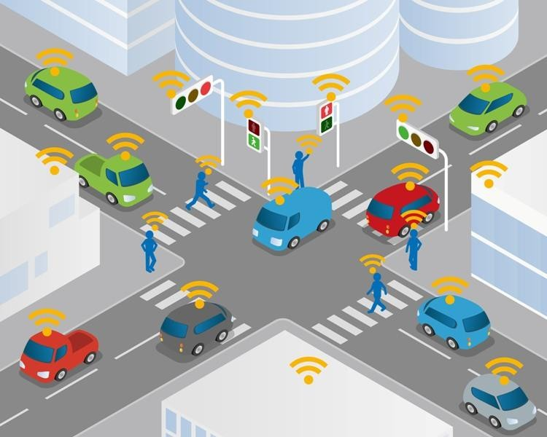
Intelligent Transportation Systems (ITS)

Slide 2
Intelligent Transportation Systems (ITS)
Intelligent Transportation Systems (ITS) combine advances in information systems, communications, sensors, advanced modelling and algorithms to improve the performance of surface transportation.
Intelligent Transportation System (ITS) applies advanced technologies of electronics, communications, computers, control, sensing and detecting in all kinds of transportation system in order to improve safety, efficiency and service, and traffic situation through transmitting real-time information.
These systems involve vehicles, drivers, passengers, road operators, and managers all interacting with each other and the environment, and linking with the complex infrastructure systems to improve the safety and capacity of road systems.

Slide 3
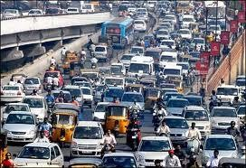
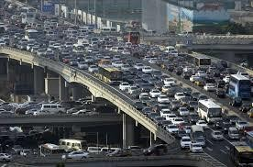
Congestion
Increased…
Travel time Travel cost Air pollution Accident risk
Options
Construct new roads
Covered in geometric design
Not likely to happen on a large
scale
Reduce Traffic
Travel demand management
Alternative transportation
Increase existing infrastructure capacity
Uses intelligent transportation systems (ITS)

Slide 4
Safety
Traditional driver training, infrastructure and safety improvements not enough to combat this threat.
Safety is one of the principal driving forces behind the evolution, development, standardization, and implementation of ITS systems
Wireless and wire line communication based information and electronics technologies to better manage traffic and maximize the utilization of the existing transportation infrastructure.
It improves driving experience, safety and capacity of road systems, reduces risks in transportation, relieves traffic congestion, improves transportation efficiency and reduces pollution.

Slide 5
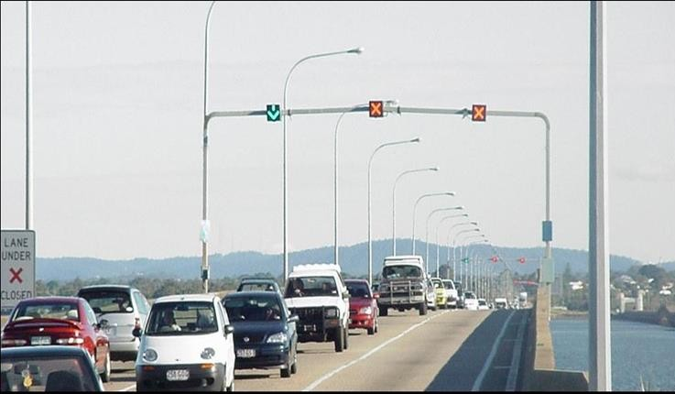
ITS-Advantages
TRAVEL
Decreased travel time
Relieve Traffic congestion
Improved safety and security
Increased reliability
Decreased cost
Improved trip planning
Improved emergency response
Economic
Increased productivity
On-time delivery
Environmental
Decreased air pollution
Fuel savings

Slide 6
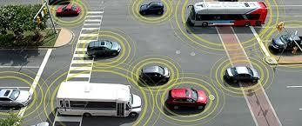
ITS Applications
Advanced Traffic Management Systems (ATMS)
 Advanced Traveler Information Systems (ATIS)
Commercial Vehicle Operations (CVO)
Advanced Transportation Public Systems (APTS)
 Advanced Vehicle Control Systems (AVCS)

Slide 7
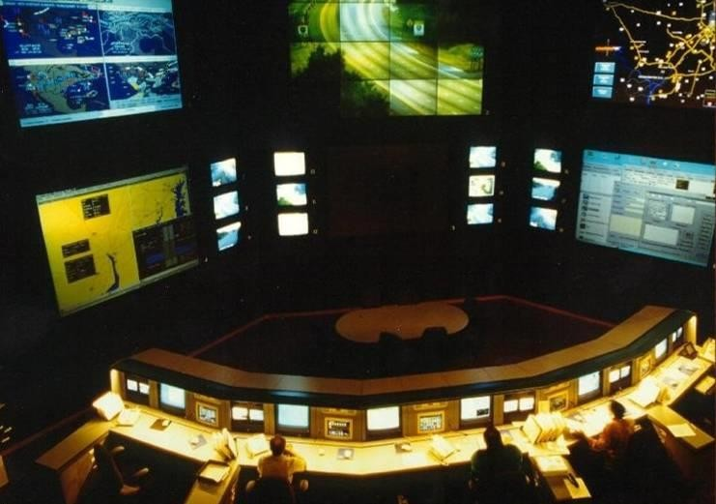
ITS Applications
1-Advanced Transportation Management Systems (ATMS)
Detects traffic situations, transmits them to control centre via communication network, and then develops traffic control strategies by combing all kinds of traffic information
Incident management, traffic light control, electronic toll collection, congestion prediction, and congestion ameliorating strategies.

Slide 8
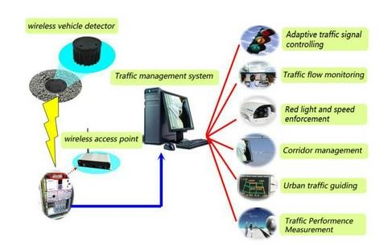
Advanced Transportation Management Systems (ATMS)

Slide 9

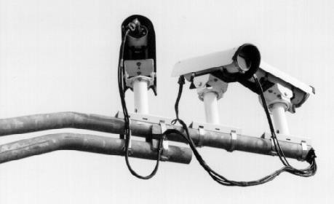
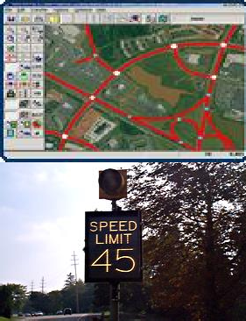
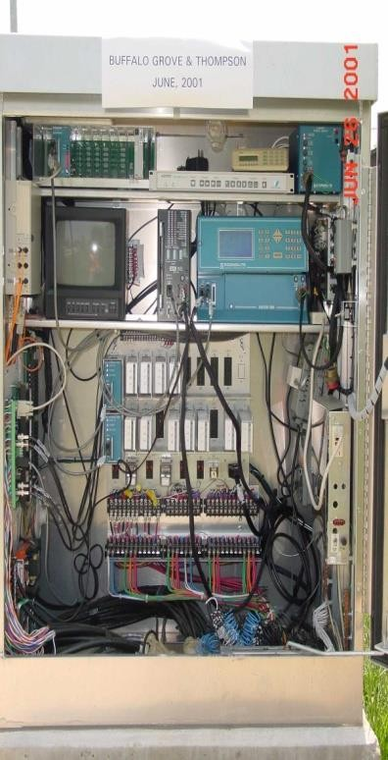
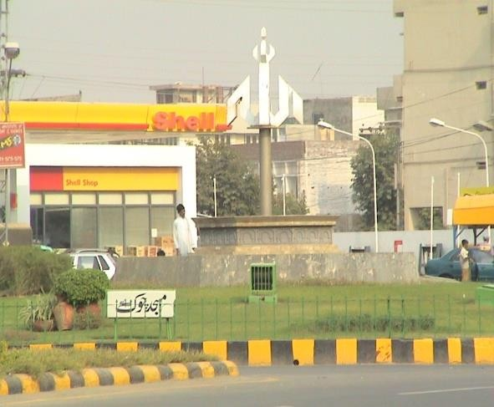
Variable Message Sign
Closed Circuit TV
Traffic Management Center
Parking Guidance System
Modernization of Existing Traffic Circles
Traffic Signal Coordination
Road Side Safety

Slide 10
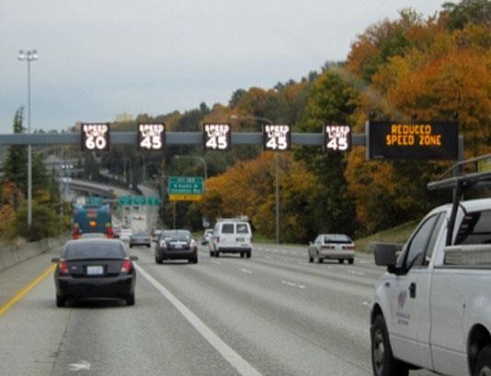
ATMS Components
Traffic Signals
Detectors
Loops
Cameras
Communication Systems
Traffic Signal Optimization & Synchronization
Physical Infrastructure
Control Cabinet
Cycle length – total time for one complete servicing of all movements in the intersection
Phase – specific movement

Slide 11
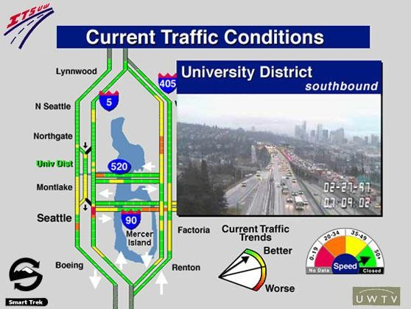
2-Advanced Traveller Information Systems (ATIS)
Road users can access real-time information in the car, at home, in the office or outdoors as the reference of choosing transportation modes, travel trips and routes.
The system mainly includes changeable message signs, GPS, internet connection, telephone, fax, cable television and mobile etc.

Slide 12
Impact of Traveller Information
Provide information to road users before and during a trip (through in-vehicle technologies)
Public transport users can also benefit from information provided through:
Vehicle location systems
Scheduling systems (e.g. online journey planners)
Freight operators can use Commercial Vehicle Operations (CVO) technologies to more effectively manage their fleets
The information not only lead to more efficient network flows but can also be used for strategic transportation planning purposes.

Slide 13
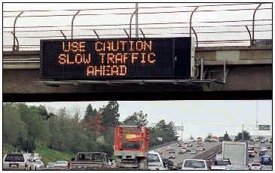
ATIS Components
Real Time Traffic information
Web
TV/ Radio
Highway advisory Radios (HARS)
Cell phones
Variable message signs (VMS)

Slide 14
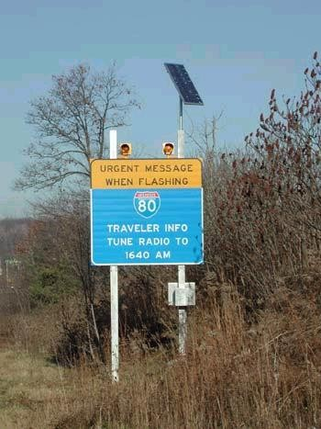
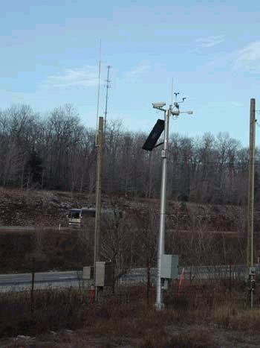
ATIS Components
Highway Advisory Radio (HAR)

Slide 15
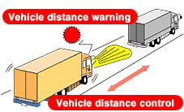
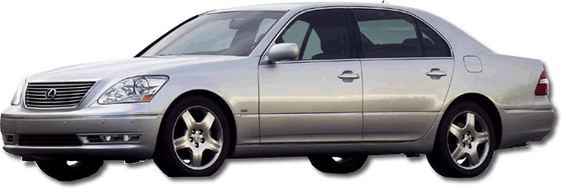
3-Advanced Vehicle Control Systems (AVCS)
Technologies that enhance driver control and vehicle safety.
 Anti-collision warning and control, driving assistance, automatic lateral/longitudinal control, and the long-run plans of automatic driving and automatic highway system

Slide 16
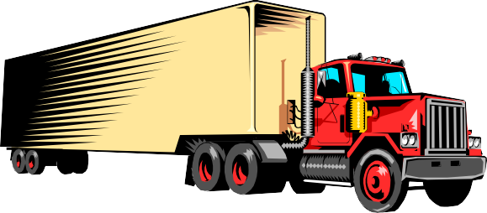
4-Commercial Vehicle Operations (CVO)
CVO applies the technology of ATMS, ATIS and AVCS in commercial vehicle
operation such as trucks, buses, taxis and ambulances in order to improve efficiency and safety
Apply, pay for and receive permits, registrations, and licenses electronically
Share of common trucking data across agencies
Exchange information electronically with roadside enforcement personnel
Electronic “screening” of trucks for safety or other regulatory violations

Slide 17
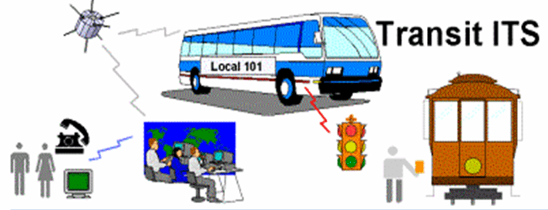
5-Advanced Public Transportation
Passenger information and technologies to enhance system operations, including fare collection, intramodal and intermodal transfers, scheduling, and headway control.
Provide better transit information to users and better transit operation

Slide 18
ITS user services
Perspective of the organization and sharing of common technical functions
Travel and traffic management
Public transportation operations
Electronic payment
Commercial vehicle operations
Advance vehicle control and safety systems
Emergency management
Information management
Maintenance and construction management

Slide 19
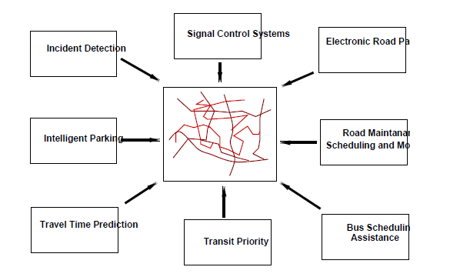
ITS user services

Slide 20
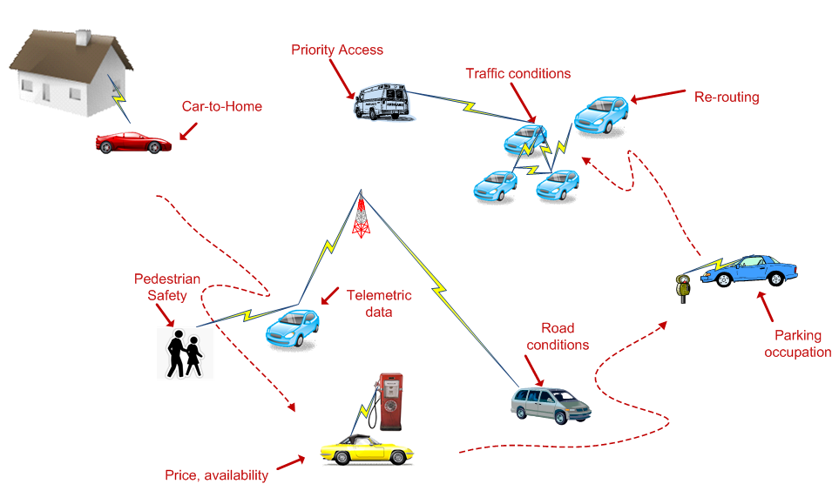

Slide 21
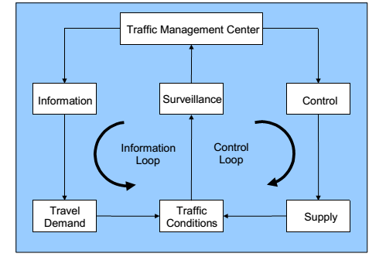
Dynamic Traffic Management

Slide 22
TRAFFIC
The movement of the people from one place to another for work, education, shopping, recreation and social meetings.
Movement of goods from farms to markets, from farms to Industries, from Industries to markets and from markets to homes and other places.

Slide 23
MANAGEMENT
Consists of Five Principles
Planning
Organizing
Leading
Staffing
Controlling

Slide 24
TRAFFIC MANAGEMENT
Application of these five principles to the traffic systems to get
Max: Efficiency
Min: Congestions
Min: Delays etc.

Slide 25
TRAFFIC MANAGEMENT & ADVANCED TECHNOLOGY
The adjustment of the Transportation System to new technology is a constant challenge.
Advanced technology for information collection, data processing, decision support and automation has created major changes in the ways people work and play.

Slide 26
ADVANCED TECHNOLOGY
 By employing new computer-based technologies, we can greatly expand our capabilities.
However, Research has discovered that available advanced technologies are substantially underutilized because
Difficult to learn
Present usability problems
People are as yet unwilling to trust them

Slide 27
DISPLAY AND COMMUNICATION TECHNOLOGY
New display and communication technologies, within vehicles and as part of the infrastructure, provide increased opportunities for controlling and influencing traffic.
Infrastructure-based displays, including Variable Message Signs (VMS), Highway Advisory Radio (HAR), provide drivers with warnings of incidents and congestions ahead.

Slide 28
TRAFFIC MANAGEMENT

Slide 29
INPUTS
Traffic and Roadway Sensors
Cellular Phone
Visual CCTV Sensors
Voice Communication Systems
Data Base Services

Slide 30
OUTPUTS
Intersection Control Devices
Variable Message Signs
Traffic Bulletin Board
Highway Advisory Radio

Slide 31
SUPPORT SYSTEM DESCRIPTIONS

Slide 32
Adaptive Control System (ATCS)
ATCS is a new concept which is used with the real
time information to synchronize the traffic signals
according to the traffic scenario
ATCS will optimize current traffic flow. It will receive roadway sensor data and use it to control Traffic Signal Timing
System gets the input from the sensor embedded In road and synchronize the group of signal accordingly.
A key feature will be its ability to integrate control across streets and freeway traffic.

Slide 33
PREDICTIVE TRAFFIC MODELING SYSTEM (PTMS)
It will use current data, historical data and weather forecasts to predict traffic flow for a few minutes into the future (5-30 min).
PTMS predictions will allow preemptive actions to be taken well before an actual traffic problem arises.

Slide 34
INCIDENT DETECTION AND LOCATION SYSTEM (IDLS)
The IDLS will detect and verify the presence of incidents on the roadway system and determine the exact location of an incident.

Slide 35
INCIDENT RESPONSE AND ADVISORY SYSTEM (IRAS)
IRAS will assist in determining the appropriate response to an incident.
Informing the motorists of a slight delay
Re-routing some traffic
Closing a major freeway and re- routing all traffic

Slide 36
INFORMATION DISSEMINATION SYSTEM (IDS)
It will interface with data services supplied to the mass media, the traffic channel and bulletin board services.
It will be capable of posting messages on Variable Message Signs (VMS) and creating voice broadcast via Highway Advisory Radio (HAR).

Slide 37
TRAFFIC MANAGEMENT TRAINING SYSTEM (TMTS)
 TMTS provides training operators to TMC
Training exercises in routine traffic management, incident management and special event management
To maintain operators skills needed in
Critical situations like extreme weather conditions

Slide 38
TRAFFIC DATA MANAGEMENT SYSTEM (TDMS)
It will serve as ATMS information hub.
It will accept all roadway sensor data and perform validity checks of such data

Slide 39
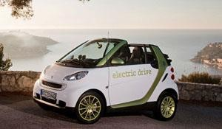
SMART CAR
First basic concept in any ITS Implementation is SMART CAR
The car is equipped with all the new electronic devices. It helps the user to use service efficiently. Some of the features of SMART CAR are:
GPS and on-board communications
Anti-collision sensors

Slide 40
SMART CAR
A smart car must be able to sense, analyse, predict and react to the road environment, which is the key feature of smart cars.
The car works with a central component that monitors the roadway and the driver.
It also evaluates the potential safety benefits. It addresses navigation, obstacle avoidance and platooning problems.
Smart cars present promising potentials to assist drivers in improving their situational awareness and reducing errors.
The smart car will adopt active measures such as stopping the car in case that the driver is unable to act properly or applying passive protection to reduce possible harm in abrupt accidents, for example, popping up airbags.

